Slide 1
《英语国家社会与文化入门》(下册）
The Society and Culture
of Major English-Speaking Countries
An Introduction
(Book Two)

Slide 2
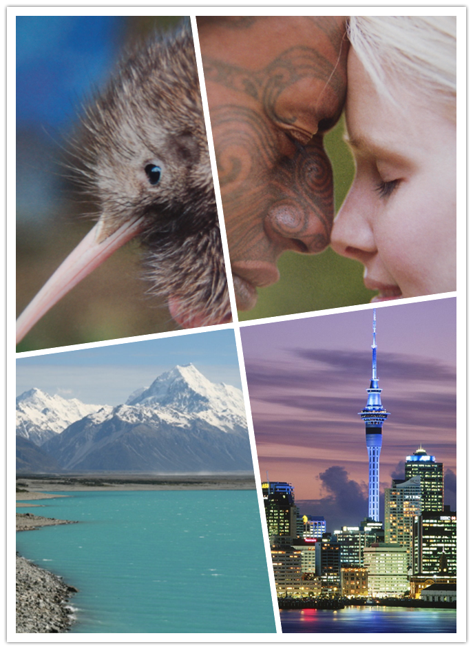
New Zealand
Unit 1 Land, People and History

Slide 3
Quiz
Give the English and a brief explanation for the following:
1 奥克兰市
2 几维鸟
3 毛利人
4 太平洋岛人
5 怀唐伊条约

Slide 4
Focal Points of the Unit
Land and Environment
Geography
Wildlife--unique flora and fauna
Environment and environmental responsibilities
New Zealanders
Population of European ancestry
Māori and Māoritanga
Pacific Islanders
History
Early settlers from East Polynesia
First European navigators arriving in 1642
The Treaty of Waitangi
New Zealand today

Slide 5
This Unit Is Divided into Three Sections:
I. Land and Environment
II. New Zealanders
III. History

Slide 6
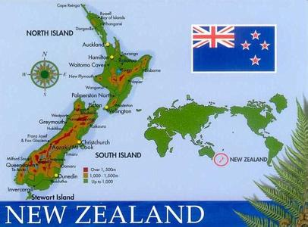

Slide 7
I. Land and Environment
Geography
Wildlife--unique flora and fauna
Environment and environmental responsibilities

Slide 8
I. Land and Environment
Georgraphy: “Aotearoa”--“Land of the long white cloud”
-a large, long group of islands, about 2000 kilometres from north to south;
-a land area of 270 500 square kilometers;
- the North Island, the South Island, the Stewart Island
-the Southern Alps and volcanoes
-two major cities--Auckland: New Zealand’s center for business, education and industry; Wellington: capital of the country

Slide 9
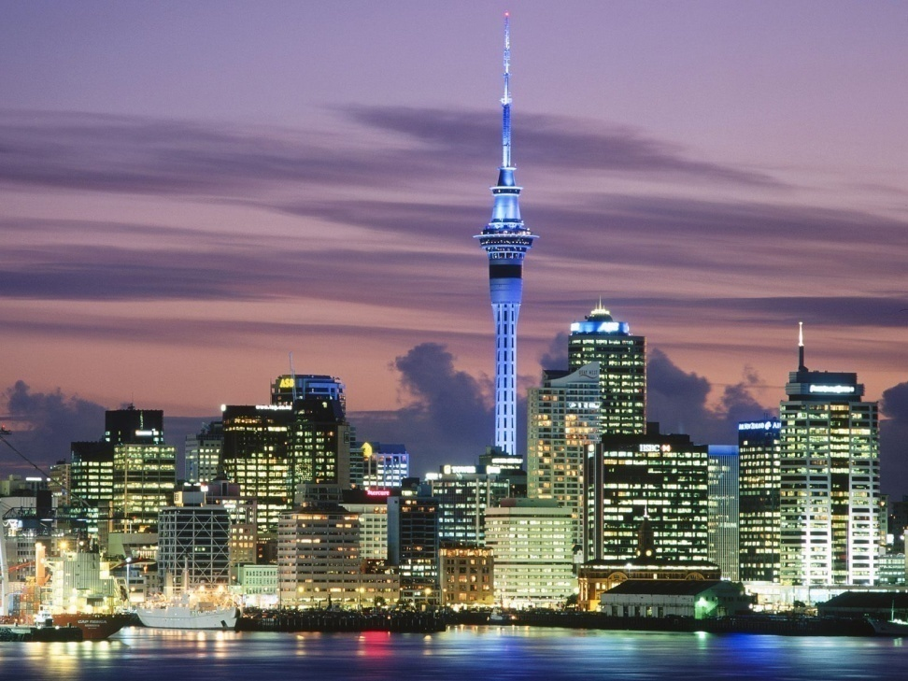
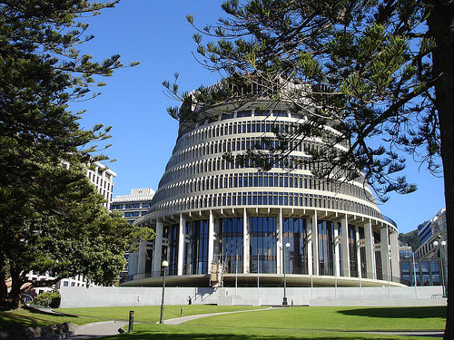
Left: Auckland, the largest city of New Zealand;
Right: Wellington’s Beehive, the national symbol of executive power

Slide 10
Climate and Wildlife
-the southern temperate latitudes midway between the Equator and the South Pole;
-maritime climate;
-seasons opposite to the Northern Hemisphere;
- isolated from the rest of the world for 80 million years, New Zealand developed unique flora and fauna.
-80% of the trees, ferns and flowering plants are endemic (found only in New Zealand);
-6.2 million hectares of native forest

Slide 11
Fauna
-25 % of New Zealand’s birds are found nowhere else on earth;
-the flightless birds
-the kiwi as a national icon of New Zealand and New Zealanders;
-other unique fauna including the Moa (a giant flightless bird), Tautara (native reptiles), bats (New Zealand’s only native land mammals), yellow-eyed penguin, Kakapo (the world’s only flightless parrot);
-diverse marine fauna in New Zealand: whales, seals, dolphins and marine birds

Slide 12
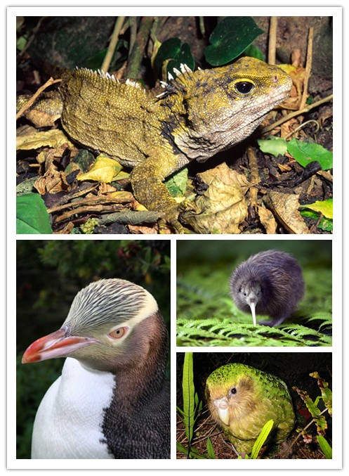
Tautara
Yellow-eyed Kiwi
penguin
Kakapo

Slide 13
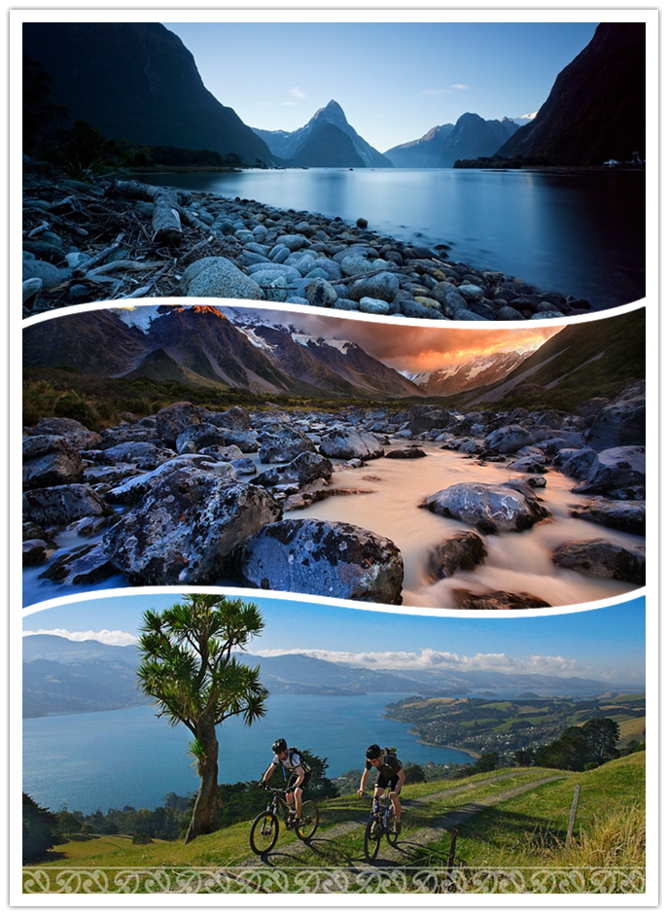
Environment
-New Zealand has a unique natural environment;
-Nature is worshiped in New Zealand;
-New Zealand has enlightened environmental policies.

Slide 14
Environmental responsibilities
-enlightened environmental policies;
-the Resource Management Act in 1991 to promote the sustainable management of natural and physical resources, bringing together laws governing land, air and water resources;
-the Department of Conversation administrating a superb system of national parks;
-reducing and recycling waste;
-influencing international attitudes on ozone depletion, whaling, sustainable forestry, climate change, biodiversity, etc.

Slide 15
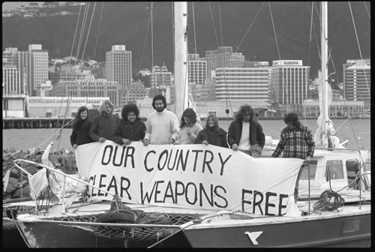
No Nukes
-In 1987 Labour passed the Nuclear Free Zone, Disarmament, and Arms Control Act.
-The US Congress downgraded New Zealand’s defense status from ally to “friend.”
-New Zealand remains a nuclear-free zone.

Slide 16
II. New Zealanders
Population of European ancestry
Māori and Māoritanga
Pacific Islanders

Slide 17
II. New Zealanders
General information
-The population of New Zealand reached 4.351 million in January 2010;
- 86% live in cities and towns, and about 75% live in the North Island;
- The New Zealand population is made up of people of different ethnicities and colours.

Slide 18
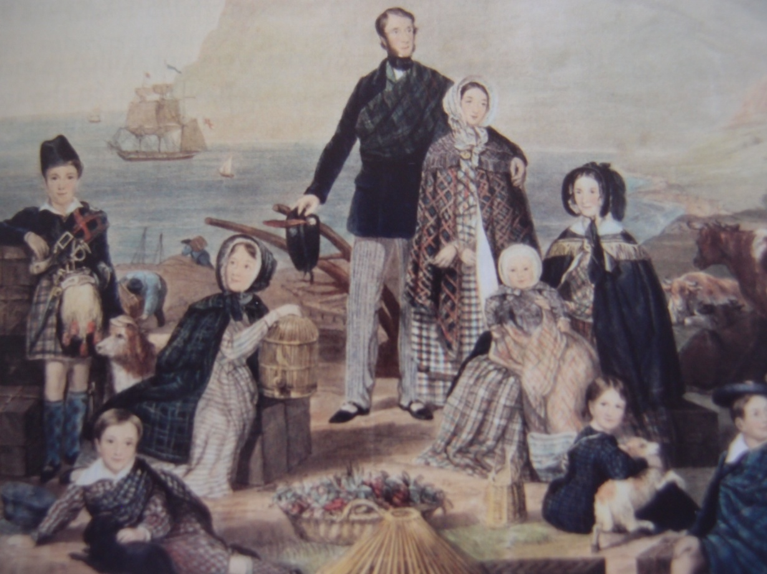
People of European ancestry
-Around 80% of New Zealanders identify themselves as having some European ancestry;
- Their forebears mainly came from England, Scotland, Ireland, but also from Germany, Italy, the Netherlands, and other nations;
-The arrival of European settlers started from the 17th century.

Slide 19
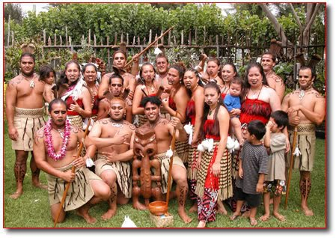
Māori
- Māori are the indigenous Polynesian people of New Zealand;
-They make up 14.5% of the total population;
-The Māori originated with settlers from eastern Polynesia, who first arrived in New Zealand in canoe voyages at some point between the 9th and 13th centuries AD.

Slide 20
Māoritanga
- Māori culture plays such an important part that New Zealand’s society is bicultural
- Māori language--Te Reo --is the second official language, and it is recognized in Parliament and in courts of law.
a. There are the kohanga reo (Maori “language nests”) all over New Zealand;
b. About 24 percent of the population speaks some Māori, and that figure is on the rise;
c. Many names of places, plants and birds are Māori, and many other Māori words have enriched New Zealand English.

Slide 21
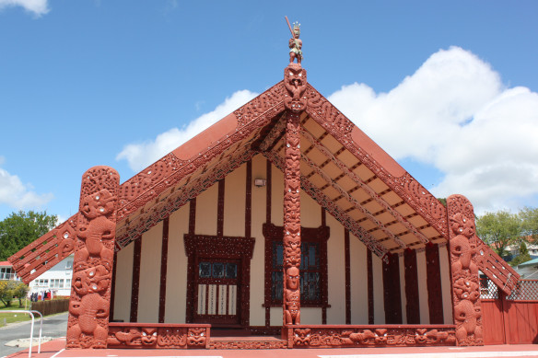
Māoritanga
-the iwi: a Māori tribe, the main social organization in Māori society;
- Māori creation myth;
-legends about Maui;
- the haka: the Māori war dance
- the hongi: the Maori sharing in the sacred act of hongi ,exchanging the ha or breath of life;
the marae: a sacred meeting place where Māori culture and language are promoted, tribal matters discussed, and ceremonies held (right: marae)

Slide 22
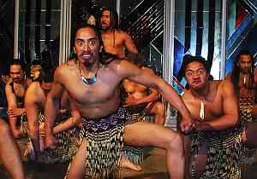
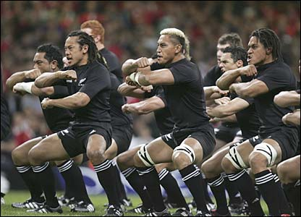
Left: the original Maori haka war dance
Right: New Zealand All Blacks pre-match haka war dance
(All Blacks: the nickname of New Zealand national rugby team, regarded as the country’s national sport.)

Slide 23
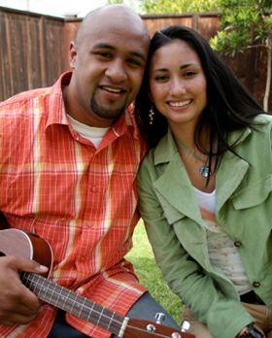
People of the Pacific Islands origin
-mainly from Western Samoa, Cook Islands, Niue, Tokelau, Tonga and Fiji
-making up about 7 % of the population of New Zealand
-today, more than 60% of Pacific Islanders born and grown up in New Zealand

Slide 24
III. History
Early settlers from East Polynesia
First European navigators arriving in 1642
The Treaty of Waitangi
Modern New Zealand society

Slide 25
III. History
First settlers from East Polynesia
-They voyaged from East Polynesia over 1000 years ago;
-They were forbearers of today’s Maori;
-They lived in tribes based on family networks;
- By 1200, they had settled the North and South Islands.

Slide 26
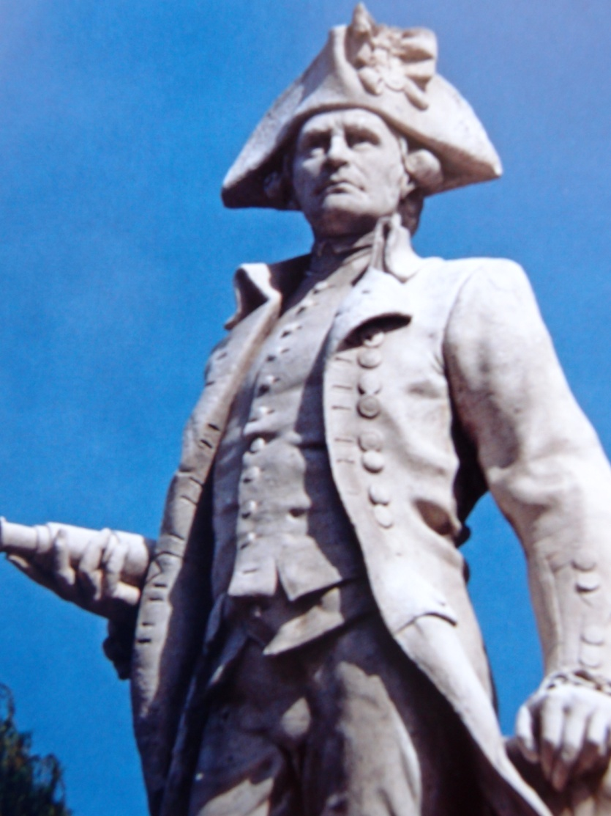
European settlers—the Pakeha
- Dutchman Abel Tasman was the first European to sight New Zealand, naming the country Staten Land, later Nieuw Zeeland;
- Englishman James Cook reached here in 1769; he traded with Maori and claimed the land for the British (right: James Cook)

Slide 27
European settlers—the Pakeha
- Sealers and whalers followed;
- Christian missionaries arrived in 1814;
- By 1840, 2 000 Europeans lived among a Maori population of 115 000;
- British settlers arrived in the 1840s and 1850s, establishing towns and clearing land for farms;

Slide 28
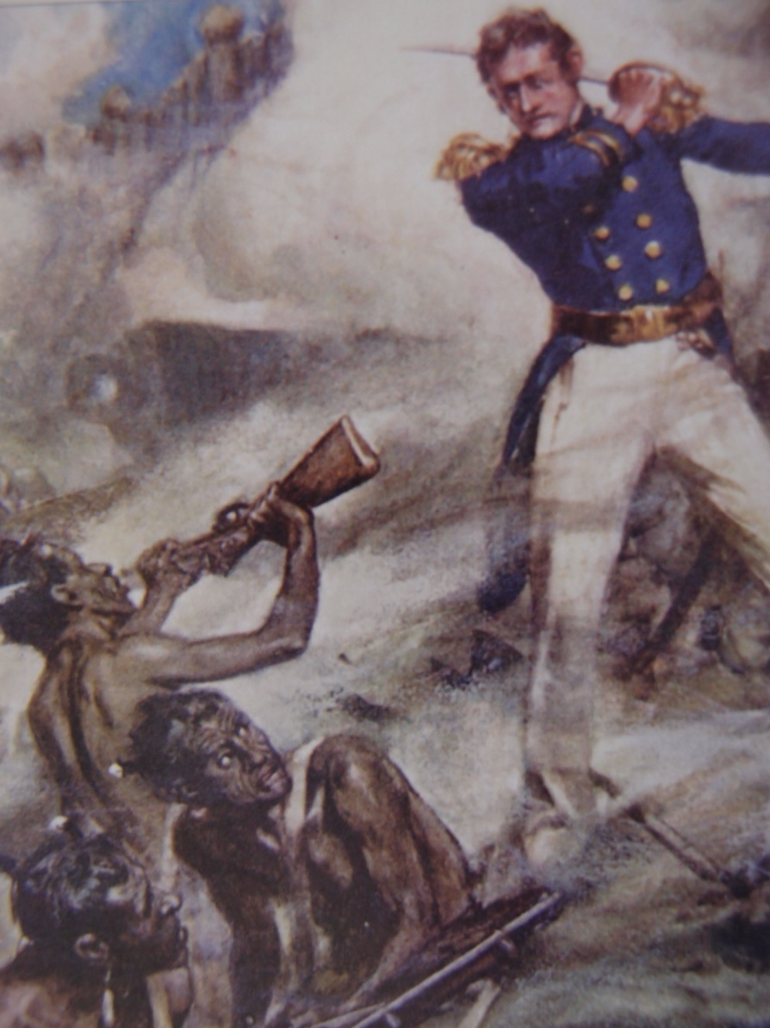
European settlers—the Pakeha
-Wars resulted between Māori and European settlers in the 1860s; decreasing the Maori population;
- Settler society boomed after the gold rushes from the 1860s;
- Roads, railways and public buildings were constructed, and national education introduced;
- A new wave of British, European and Australian migrants arrived in the 1880s.

Slide 29
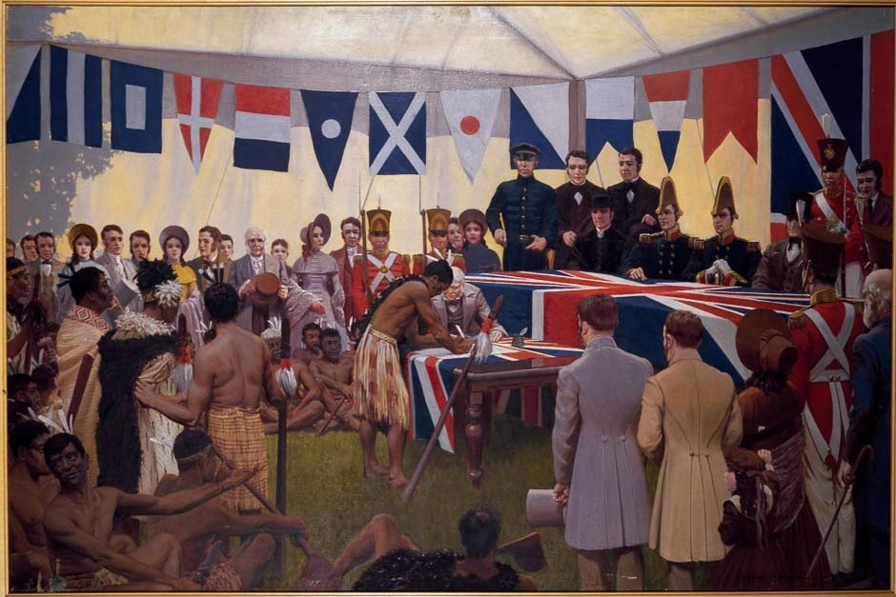
The Treaty of Waitangi
The Treaty was first signed on 6 February 1840 by representatives of the British Crown and various Māori chiefs from the North Island of New Zealand.

Slide 30
The Treaty of Waitangi
-The Treaty established a British Governor of New Zealand, recognized Māori ownership of their lands and other properties, and gave the Māori the rights of British subjects;
-Māori and non- Māori New Zealanders had different interpretations of the Treaty, resulting in wars between them in the early 1860s;
- By the 1890s less than one-sixth of New Zealand was owned by Māori;
- From the late 1960s Māori began drawing attention to breaches of the Treaty;
- The Waitangi Tribunal was established in 1975 in an effort to address past wrongs and Māori grievances;
- The Government aims to have all claims under the Waitangi Tribunal settled by 2014 with around $55 million a year paid in Treaty settlement.

Slide 31
Modern New Zealand Society
- Worldwide economic depression hit New Zealand in the late 1920s;
- State welfare was expanded from the 1930s -- higher pensions, unemployment and sickness benefits, and medical care was subsidized;
- In 1947, New Zealand ratified the Statute of Westminster, which gave it complete autonomy from Britain in foreign as well as domestic affairs;
-Urbanization, especially of Maori, and economic prosperity marked post-war New Zealand;

Slide 32
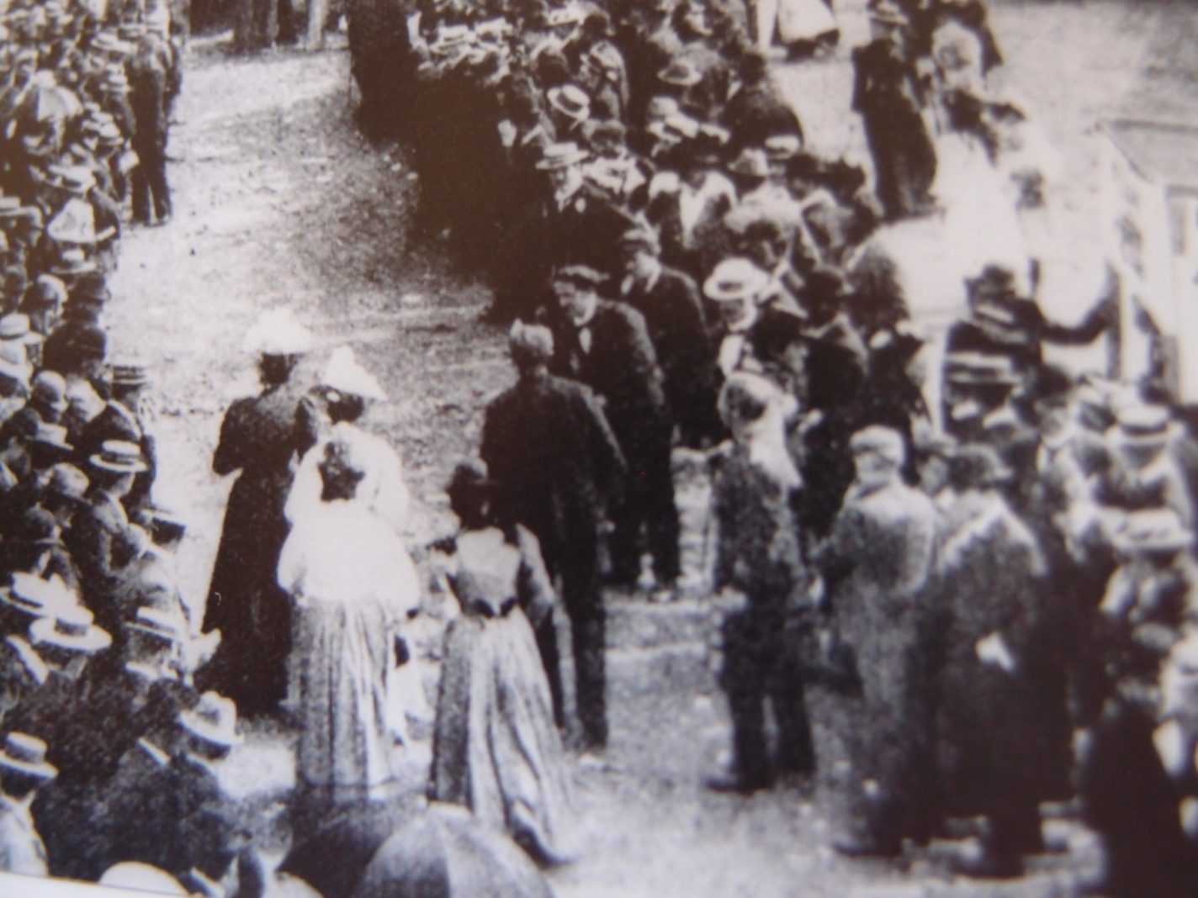
Modern New Zealand society
In 1893 New Zealand became the first country in the world to give women the national vote. More women worked outside the home, and equal pay was introduced in 1972. (right: women waiting to vote)

Slide 33
New Zealand Today
-The mid-1980s brought profound changes in foreign affairs and the economy: New Zealand was declared nuclear-free. Free-market policies opened up the economy, and the role of government was reformed;
-New Zealand has gone through many reforms and changes in the past decades, economically and socially, the biggest change being growing biculturalism with Māori culture penetrating New Zealand’s society;
-New Zealand of the 21st century faces the world with a confident and independent national identity.

Slide 34
Questions for Discussion
A. What are some of the distinct features of New Zealand’s geography and natural environment?
B. What are the structural components of New Zealand’s population? In what way are they related to New Zealand’s history?
C. When did the first European navigators arrive in New Zealand? How did New Zealand evolve to what it is today?
D. What role does the Maori culture play in New Zealand society?

Slide 35
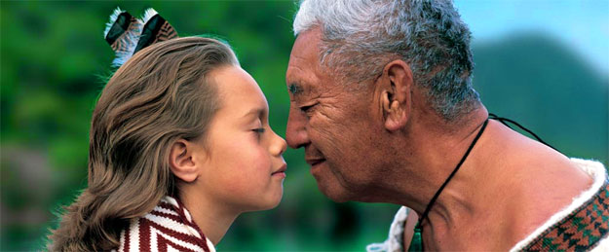
The Maori hongi--sharing in the sacred act of hongi, exchanging the ha or breath of life

Slide 36
The End
高等教育出版社
2015

